Slide 1


Cryptography & Network Security
Lecture Slide 3
CSE Department
UEM, Kolkata

Slide 2

Topics to be Covered
Symmetric Key Model
Classical Encryption Techniques
Substitution Techniques
1.Caesar Cipher
2. Monoalphabetic Ciphers
3. Playfair Cipher
4. Hill Cipher
5. Polyalphabetic Ciphers
6. One-Time Pad

Slide 3
Symmetric Key Model
A symmetric encryption scheme has five ingredients :
● Plaintext: This is the original intelligible message or data that is fed into the algorithm as input.
● Encryption algorithm: The encryption algorithm performs various substitutions and transformations on the plaintext.
● Secret key: The secret key is also input to the encryption algorithm. The key is a value
independent of the plaintext and of the algorithm. The algorithm will produce a different output
depending on the specific key being used at the time. The exact substitutions and
transformations performed by the algorithm depend on the key.
● Cipher text: This is the scrambled message produced as output. It depends on the plaintext and
the secret key. For a given message, two different keys will produce two different cipher texts.
The cipher text is an apparently random stream of data and, as it stands, is unintelligible.
● Decryption algorithm: This is essentially the encryption algorithm run in reverse. It takes the
Cipher text and the secret key and produces the original plaintext

Slide 4
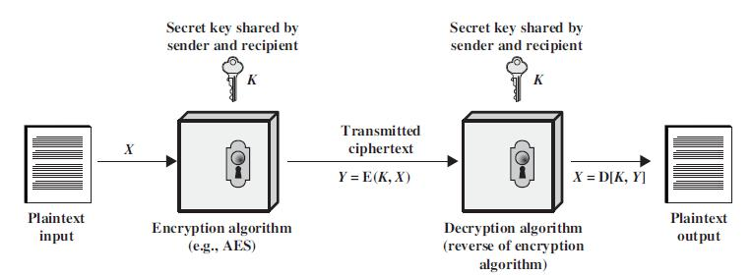
Symmetric Key Model

Slide 5
Classical Encryption Techniques
In this section, we will learn about a sampling of what might be called classical encryption techniques. A study of these techniques enables us to illustrate the basic approaches to symmetric encryption used today and the types of cryptanalytic attacks that must be anticipated.
The two basic building blocks of all encryption techniques are substitution and transposition.

Slide 6
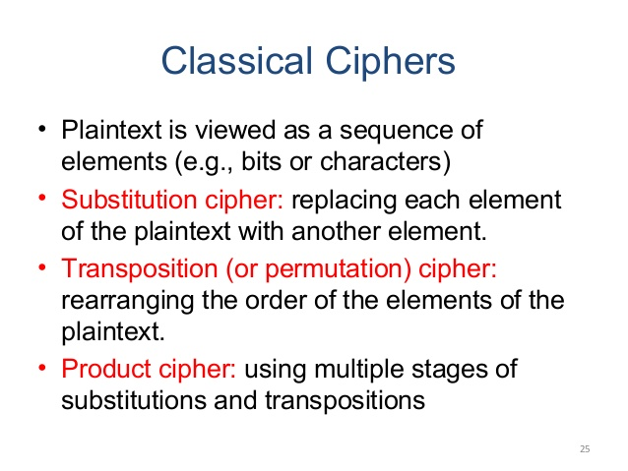

Slide 7

Substitution Techniques
A substitution technique is one in which the letters of plaintext are replaced by other letters or by numbers or symbols.
If the plaintext is viewed as a sequence of bits, then substitution involves replacing plaintext bit patterns with cipher text bit patterns.
Note
A substitution cipher replaces one symbol with another.

Slide 8
Caesar Cipher
The earliest known use of a substitution cipher, and the simplest, was by Julius Caesar. The Caesar
cipher involves replacing each letter of the alphabet with the letter standing three places further down the alphabet. For example,
plain: meet me after the toga party
cipher: PHHW PH DIWHU WKH WRJD SDUWB

Slide 9
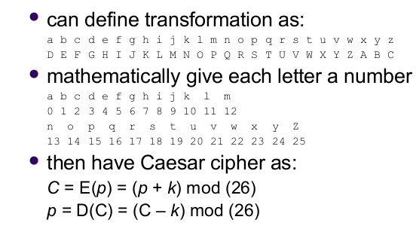
Caesar Cipher

Slide 10
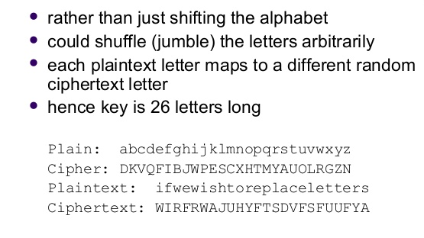
Monoalphabatic Cipher

Slide 11
Playfair cipher
The best known multiple letter encryption cipher is the playfair, which treats digrams in the plaintext as single units and translates these units into cipher text digrams.
This cipher was actually invented by British scientist Sir Charles Wheatstone in 1854, but it bears the name of his friend Baron Playfair of St. Andrews, who championed the cipher at the British foreign office.
The playfair algorithm is based on the use of 5x5 matrix of letters constructed using a keyword.

Slide 12
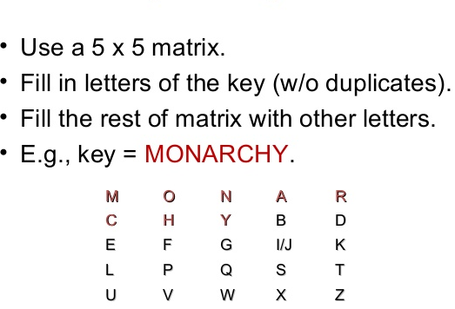
Playfair cipher

Slide 13
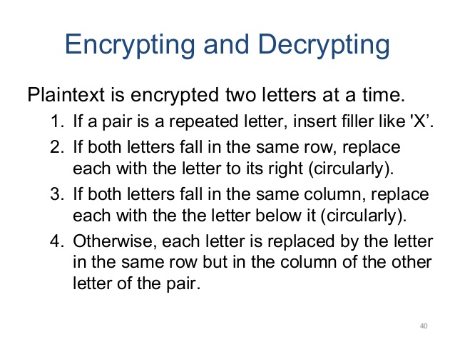
Playfair cipher

Slide 14
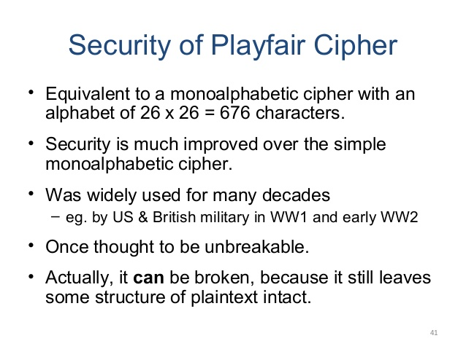
Playfair cipher

Slide 15
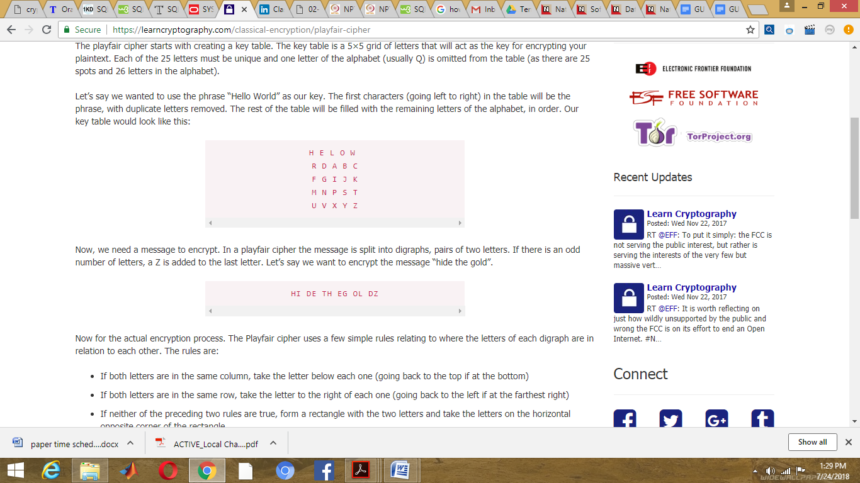
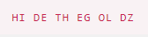
Playfair cipher
Let’s say we wanted to use the phrase “Hello World” as our key. The first characters (going left to right) in the table will be the phrase, with duplicate letters removed. The rest of the table will be filled with the remaining letters of the alphabet, in order. Our key table would look like this:
Let’s say we want to encrypt the message “hide the gold”.

Slide 16
Playfair cipher
Now for the actual encryption process. The Playfair cipher uses a few simple rules relating to where the letters of each digraph are in relation to each other. The rules are:
If both letters are in the same column, take the letter below each one (going back to the top if at the bottom)
If both letters are in the same row, take the letter to the right of each one (going back to the left if at the farthest right)
If neither of the preceding two rules are true, form a rectangle with the two letters and take the letters on the horizontal opposite corner of the rectangle
Using these rules, the result of the encryption of “hides the gold” with the key of “hello world” would be “LF GD MW DN WO CV”.

Slide 17
Hill Cipher
The Hill Cipher uses an area of mathematics called Linear Algebra, and in particular requires the user to have an elementary understanding of matrices.
To encrypt a message using the Hill Cipher we must first turn our keyword into a key matrix (a 2 x 2 matrix for working with digraphs, a 3 x 3 matrix for working with trigraphs, etc). We also turn the plaintext into digraphs (or trigraphs) and each of these into a column vector. We then perform matrix multiplication modulo the length of the alphabet (i.e. 26) on each vector. These vectors are then converted back into letters to produce the ciphertext.

Slide 18

1st Step
We shall encrypt the plaintext message "short example" using the keyword hill and a 2 x 2 matrix. The first step is to turn the keyword into a matrix. If the keyword was longer than the 4 letters needed, we would only take the first 4 letters, and if it was shorter, we would fill it up with the alphabet in order (much like a Mixed Alphabet).
The keyword written as a matrix.

Slide 19

2nd Step
With the keyword in a matrix, we need to convert this into a key matrix. We do this by converting each letter into a number by its position in the alphabet (starting at 0). So, A = 0, B = 1, C= 2, D = 3, etc.
The key matrix (each letter of the keyword is converted to a number).

Slide 20

3rd Step
We now split the plaintext into digraphs, and write these as column vectors. That is, in the first column vector we write the first plaintext letter at the top, and the second letter at the bottom. Then we move to the next column vector, where the third plaintext letter goes at the top, and the fourth at the bottom. This continues for the whole plaintext.
The plaintext "short example" split into column vectors.

Slide 21

4th Step
Now we must convert the plaintext column vectors in the same way that we converted the keyword into the key matrix. Each letter is replaced by its appropriate number.
The plaintext converted into numeric column vectors.

Slide 22




5th Step
Now we must perform some matrix multiplication. We multiply the key matrix by each column vector in turn. We shall go through the first of these in detail, then the rest shall be presented in less detail. We write the key matrix first, followed by the column vector.

Slide 23

6th Step
Next we have to take each of these numbers, in our resultant column vector, modulo 26 (remember that means divide by 26 and take the remainder).
Finally we have to convert these numbers back to letters, so 0 becomes "A" and 15 becomes "P", and our first two letters of the ciphertext are "AP".
The whole calculation: converting to numbers; the matrix multiplication; reducing modulo 26; converting back to letters.

Slide 24
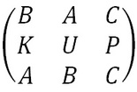
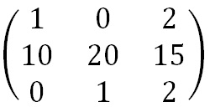
For 3 x 3
We shall encrypt the plaintext message "retreat now" using the key phrase back up and a 3 x 3 matrix. The first step is to turn the key phrase into a matrix. Notice that the key phrase is a few letters short, so we fill in the final elements with the start of the alphabet.
The keyword written as a matrix.
The Key Matrix obtained by taking the numeric values of the letters of the key phrase.

Slide 25
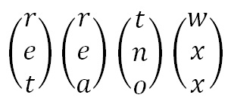
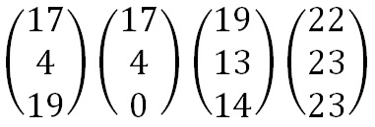
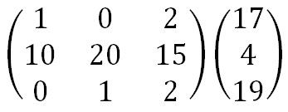
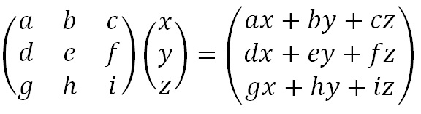
Next Step
Now we split the plaintext into trigraphs (we are using a 3 x 3 matrix so we need groups of 3 letters), and convert these into column vectors. However, since the plaintext does not go perfectly into the column vectors, we need to use some nulls to make the plaintext the right length. We then convert these into numeric column vectors.

Slide 26
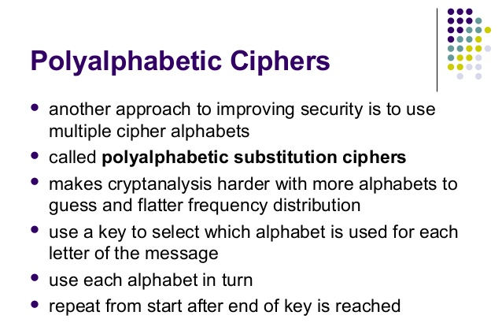

Slide 27
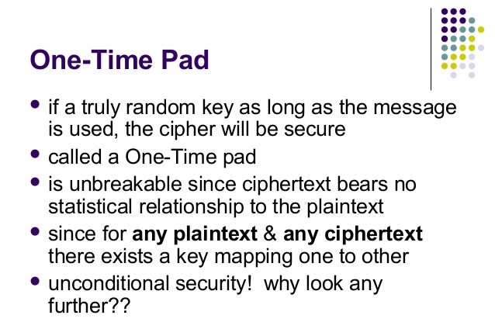

Slide 28


